Slide 1
KnowYourProf Teachers’ Information and Assessment System
24.03.19

Slide 2
Hello!
We are,
Syed Sanzam (16.01.04.042)
Nusrat Hossain (16.01.04.045)
Saiful Islam (16.01.04.040)
24.03.19

Slide 3
Introduction:
Now that an entity-relationship diagram (ERD) is a strong individuality that indicates the robustness of a system, its necessary to design it precisely. Here it will deal with different kinds of data, so understanding the data relationship as well as the data flow is a great concern for developing the system.
24.03.19

Slide 4
Entity names with Primary and Foreign Keys
Table Name | Primary Key | Foreign Key
USER | UserID
COMMENT | CommentID
STATUS | StatusID
DEPARTMENT | DepartmentID
COURSE | CourseID
TEACHER_ATTRIBUTE | AttributeID
TEACHER_ATTRIBUTE_STATUS | Attribute_Status_ID
24.03.19

Slide 5
Entity names with Primary and Foreign Keys
Table Name | Primary Key | Foreign Key
JUNCTION_DEPARTMENT_COURSE | DepartmentID, CourseID | DepartmentID, CourseID
JUNCTION_COURSE_TEACHER | TeacherID, CourseID | TeacherID, CourseID
JUNCTION_TEACHER_ATTRIBUTE | JunctionTeacherAttributeID | TeacherID, AttributeID, AttributeStatusID
TEACHER | TeacherID | DepartmentID, StatusID
24.03.19

Slide 6
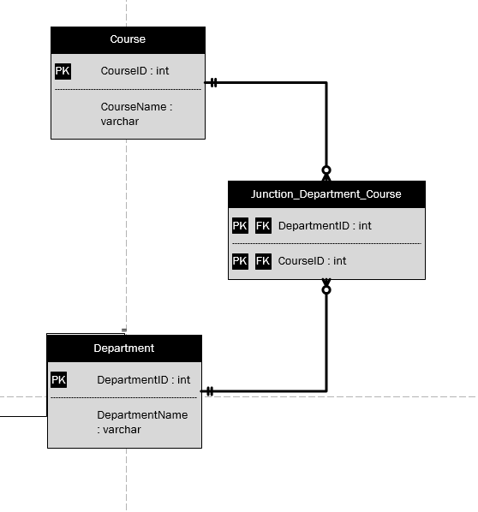
Entity-Relationship Diagram
24.03.19

Slide 7
Dummy data for justification
DEPARTMENT
COURSE
DepartmentID | Department Name
1 | Computer Science and Engineering
2 | Civil Engineering
3 | Electrical Engineering
CourseID | CourseName
1 | Information System Design
2 | Database Lab
3 | Mathematics -I
JUNCTION_DEPARTMENT_CORUSE
DepartmentID | CourseID
1 (CSE) | 1 (ISD)
1 (CSE) | 2 (DL)
1 (CSE) | 3 (M)
3 (EEE) | 3 (M)
24.03.19

Slide 8
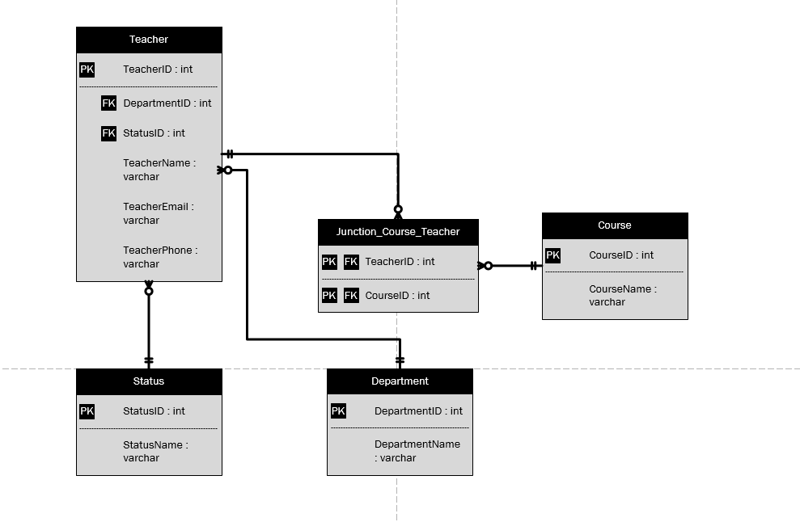
Entity-Relationship Diagram
24.03.19

Slide 9
Dummy data for justification
STATUS
JUNCTION_COURSE_TEACHER
DepartmentID | Department Name
1 | Lecturer
2 | Assistant Professor
3 | Professor
TeacherID | CourseID
1 (Nayeem Sir) | 1 (ISD)
1 (Nayeem Sir) | 2 (DL)
2 (Shoeb Sir) | 3 (Math)
TEACHER
TeacherID | TeacherName | TeacherEmail | TeacherPhone | DepartmentID | StatusID
1 | Mir Tafseer Nayeem | mtn@gmail.com | 01001234567 | 1 (CSE) | 2 (AP)
2 | Shoeb Shahriar | ss@gmail.com | 01000123456 | 1 (CSE) | 2 (AP)
3 | Fayza Amreen | fa@gmail.com |  | 1 (CSE) | 1 (L)
24.03.19

Slide 10
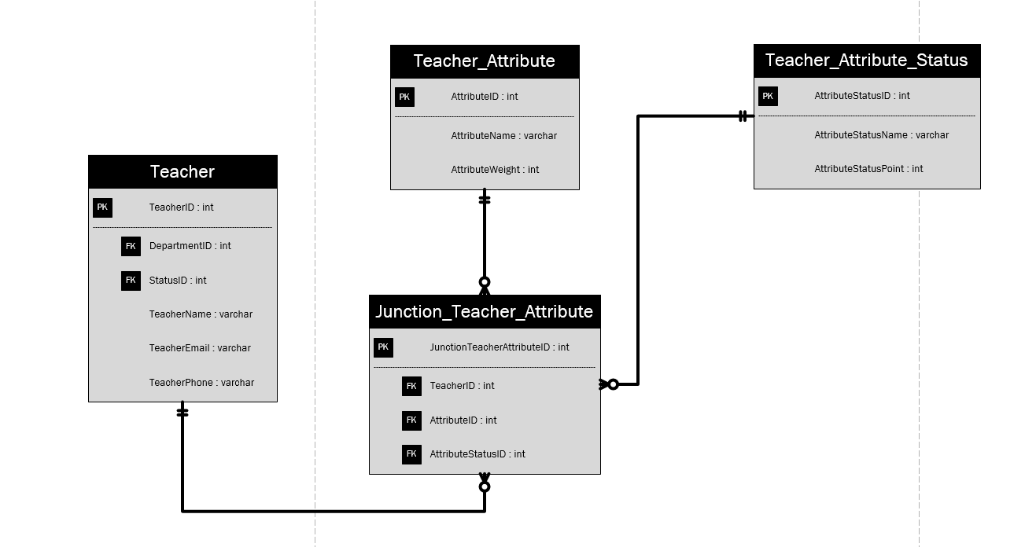
Entity-Relationship Diagram
24.03.19

Slide 11
Dummy data for justification
TEACHER_ATTRIBUTE
TEACHER_ATTRIBUTE_STATUS
AttributeID | AttributeName | AttributeWeight
1 | Patience | 5
2 | Professionalism | 3
3 | Integrity | 1
AttrStatusID | AttrStatusName | AttrStatusPoint
1 | Low | 1
2 | Medium | 2
3 | Excellent | 3
JUNCTION_TEACHER_ATTRIBUTE
JuncAttrTeachID | TeacherID | AttributeID | AttributeStatusID
1 | 1 (Nayeem Sir) | 1 (Pat) | 1 (Low)
2 | 1 (Nayeem Sir) | 2 (Prof) | 2 (Med)
3 | 1 (Nayeem Sir) | 3 (Int) | 3 (Exc)
24.03.19

Slide 12
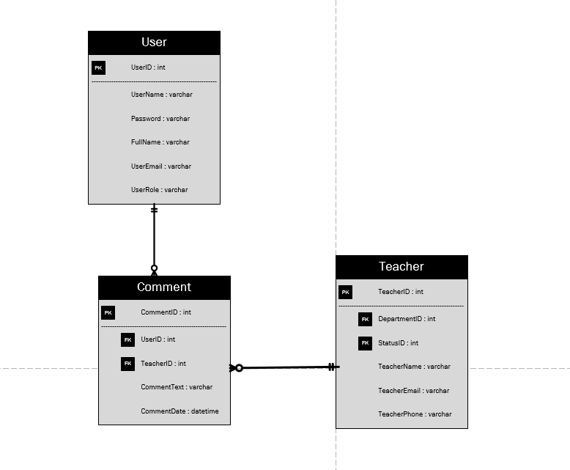
Entity-Relationship Diagram
24.03.19

Slide 13
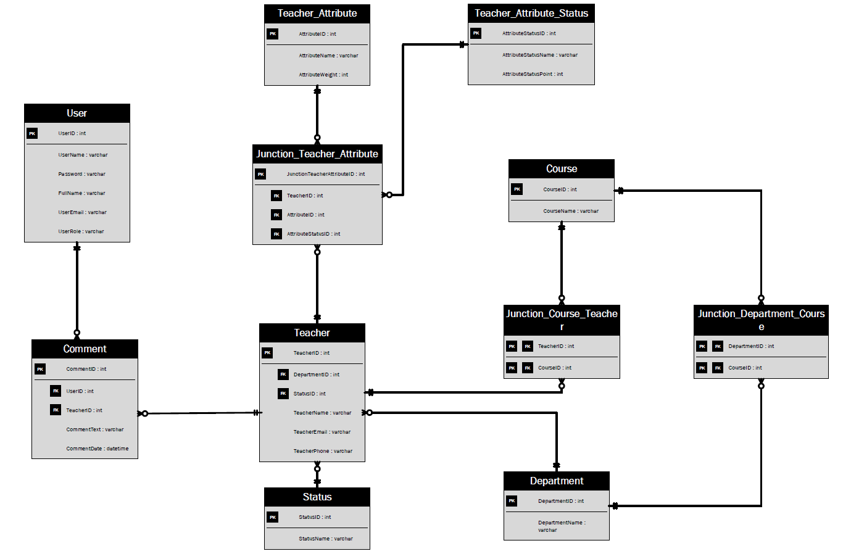
Complete ERD
24.03.19

Slide 14
Conclusion:
When it comes to build a strong database, we need a precise visualization of the data relationships. And as it is a fundamental part of the system, relationship accuracy should be at its best. Although there are many approaches to form a relationship, most accurate and less memory consuming approach is appreciated.
24.03.19

Slide 15
Thanks!
24.03.19

